Slide 1
How much will it take to break you?
Bwahahaha…

Slide 2
When real life hits…
Normal payday!
Pay your bills and expenses
Prep your bank account for some serious damage…

Slide 3
Pay day!
If you have a master’s degree: $60,000
Make sure you’ve paid your $20,000 in tuition
If you have a bachelor’s degree: $50,000
Make sure you’ve paid your $40,000 in tuition
If you only turned in a resume: $20,800
If you’re still @ minimum wage: $15,080

Slide 4
First: Federal taxes
Single-person tax brackets:
$15,080 = 17.65% of your paycheck
$20,800 = 22.65% of your paycheck
$49,920-$50,000 = 32.65% of your paycheck
WAIT! Subtract $4000 from your taxes
Married tax brackets:
<$18,550 combined = 17.65% of your paycheck
$18,550-$75,000 = 22.65% of your paycheck
$75,000-$151,000 = 32.65% of your paycheck
WAIT! Subtract $8,000 from your taxes

Slide 5
Second: State taxes
State income tax:
Find 5% of today’s paycheck and include it in what must be paid to the IRS

Slide 6
Other yearly expenses
Total your normal costs for:
Car insurance
House payments OR rent
Food

Slide 7
COL: Utilities
* W/roommates, pay $200/# of roommates
* If you live alone, pay $200
*If you own a home, pay:
Water bill: $100 per month
Garbage/sewer: $15 per month
Gas bill: $150 per month
Electric bill: $75 per month

Slide 8
COL: City fees
County general funds: $300
School levy (tax): $800
State basic school levy (tax): $200
Library tax: $30
City tax: $400
Mosquito abatement: $15
County water: $30
Central Utah water cost: $50
Multi-county assessing and collecting: $1
County assessing and collecting: $50

Slide 9
COL: Must/can
MUST pay:
Gas/car upkeep: $10,000 per year
Clothing: $2,000 per year
CAN pay:
Phone bills: $360 per year
Internet: $840 per year
Entertainment: $2,000 per year

Slide 10
Now real life hits…
Uninsured driver hits your car
The accident is 100% their fault
That would normally mean they and their insurance pay 100% of the damages, but…
You can sue the other driver, but they have no $$$
Total: $700 for deductible + $180 for a rental car
Plus: $500 for 5 chiropractor visits

Slide 11
Now real life hits…
Uninsured driver hits you as you ride your bike
The accident is 100% their fault
That would normally mean they and their insurance pay 100% of the damages, but…
You can sue the other driver, but they have no $$$
Total: $30,000 for medical bills + 800 new bike
Plus: $1,000 for 10 chiropractor visits

Slide 12
Personal expenses
Tooth pulled: $500 ($300 with dental insurance)
Root canal: $2,500 ($1,000 with dental)
You pulled out a tooth while eating a cinnamon bear:
Bone graft: $1,100
Dental flipper: $500
Tooth implant: $3,000

Slide 13
More expenses
New tires for your car OR new bike: $800
Broken water heater: $1,000
Washer breaks & floods house — you must replace the floor & drywall: $6,000
Braces: $7,500
If you have dental insurance, the cost is $3,000

Slide 14
Custody evaluation
A legal process where a court-appointed mental health expert evaluates a family and makes recommendations regarding parenting
$10,000

Slide 15
Adoption
Home study, court and legal fees, preadoption and post adoption counseling for birth parents, birth parent medical and legal expenses, adoptive parent preparation and trianing, social work servcices needed to match a child with a prospective family, interim care for a child, postplacement supervision until the adoption is supervised…
$20,000

Slide 16
International adoption
China ($36,000)
Ethiopia ($32,000)
Haiti ($38,000)
South Korea ($44,000)
Ukraine ($38,000)
Uganda ($36,000)

Slide 17
Stolen identity!
Someone stole your identity and maxed out your credit card
Banks are generally quite understanding when this happens
But you still have to pay $5,000

Slide 18
Fire!
If you don’t have homeowners/renter’s insurance, redecorating and restocking your house will cost you $10,000 per room ($2,000 if you do)
This is for both an apartment AND a house — there is no escape

Slide 19
Lost your job!
Both of you (if married) have lost your job ☹
If you’re single, you lost your job ☹
Subtract all of your normal expenses for a year, but DON’T add any new money to your bank account

Slide 20
Lost your job again!
Your job has gone overseas, so you need training to get a new job:
Job re-training: $12,000 (two years)
NO income for those 2 years, but you must still pay your bills

Slide 21
Lawsuit!
Your neighbors have sued you for being annoying
The lawsuit fails, but you’re still hit with expenses
Average cost of a civil suit in America: $10,000

Slide 22
Car accident
Accident, and it’s your fault:
Your insurance will pay some, but not all
Costs for you:
Physical therapy $175 an hour
Emergency room: $1,200
MRI: $2,500
Pay to fix the other person:
$40,000

Slide 23
Gambling debt!
You tried to win big in Vegas and became a gambling addict…
The average gambling debt is…
$86,000

Slide 24
Divorce!
Contested divorce: 2 parties don’t agree
Uncontested divorce: 2 parties do agree
Yours was contested, so…
Split your assets in half
Pay each of your attorneys $30,000
Pay $10,800 for your new apartment
Pay $16,000 for a new car

Slide 25
Tornado!
Everything you own has been wiped out!
Build a new house: $305,372
Furnish that new house: $50,000

Slide 26
Hurricane!
Everything you own has been wiped out again!
Move across the country to a safer place: $8,000
Build a new house: $305,372
Furnish that new house: $50,000

Slide 27
Earthquake!
Actually, it turns out there is no safe place…
Build a new house: $305,372
Furnish that new house: $50,000

Slide 28
What is the lesson here?
Where do you go when your world falls apart?

Slide 29
Government aid: Benefits.gov
The government maintains a social safety net to help people who are struggling
Unemployment benefits
Food stamps
Medical coverage
Health insurance subsidies
Welfare or temporary assistance for needy families
Benefits for people with disabilities
Benefits for military veterans and their families

Slide 30
The civic safety net
Americans give an estimated $358 billion to charity each year
“Americans have it in their DNA to be philanthropic”
2/3 of Americans make charitable donations each year
More Americans give to charity than vote for president

Slide 31
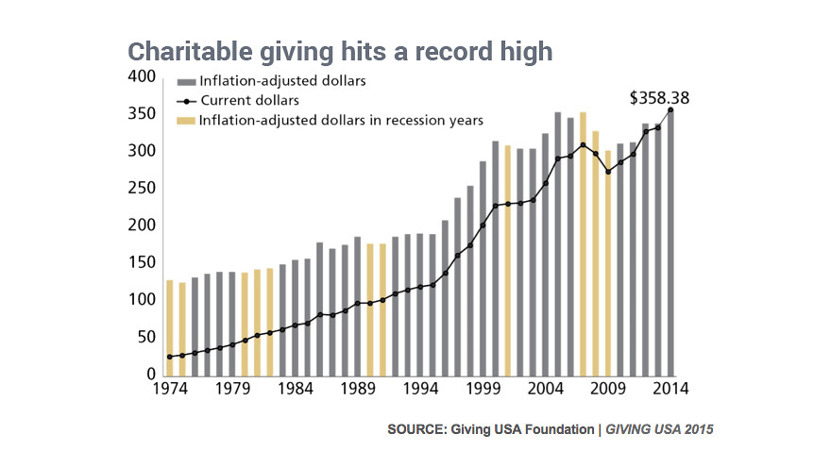

Slide 32
