Slide 1
Real Life: Day 1
Happy 16th birthday!

Slide 2
Real life simulation
Over the next 14 weeks, you will get to experience government in action
Every class, you’ll get 2 years older
As you age, you’ll get to experience all the joys of adulthood: Jobs, taxes, paychecks, food prices, college tuition, health insurance, marriage, kids, lawsuits, and eventually, retirement

Slide 3
Congrats! You got a job!
Step 1: Name and design the gas station that just hired you…
Step 2: Embrace your new job as a pump jockey
Step 3: Do some math!
You make Utah’s minimum wage per hour, which is…
$7.25 per hour
You work 20 hours per week

Slide 4
Minimum wage laws
The federal government has set the national minimum wage at $7.25 an hour
The minimum wage is set by the Fair Labor Standards Act
States get to decide their own wage if it’s higher than the federal government’s
Washington, D.C.’s minimum is $11.50

Slide 5
Two years of work
You get paid $7.25 per hour
You work 20 hours a week
There are 52 weeks in a year
Do the math — how much do you make in a year?
Take that total and double it
You make???
$15,080 ($7,540 per year)

Slide 6
Two years of expenses
Your paycheck: $7,540
What are your expenses?
Taxes
Rent
Food
Phone plan
Car insurance
Notes:
http://och.byu.edu/compdataaverage.html

Slide 7
U.S. taxes
What taxes do you pay?
Federal income taxes
State income taxes
Payroll taxes (Social Security & Medicare)
Sales tax
Excise taxes
Property tax
Estate tax
Gift taxes

Slide 8
Payroll taxes
6.2% of your paycheck MUST go to Social Security
How much is 6.2% of $7,540?
The employer will also pay 6.2% per employee
1.45% of your paycheck MUST go to Medicare
How much is 1.45% of $7,540?
The employer will also pay 1.45% per employee

Slide 9
Real-life costs
Total tax:
Car insurance:
Boys = $600 per month
Girls = $500 per month
Phone plan:
$30 per month
Food?
Rent?

Slide 10
Your Balance Sheet #1
Income: $7,540
Minus: 10% (income tax)
Minus: 6.2% (Social Security)
Minus: 1.45% (Medicare)
Minus: $600 OR $500 per month (12 months)
Minus: $30 per month (12 months)
- Do all that math, then double the money you have left — that’s your income for the two years you were 16 and 17
- If you have negative money, you are in debt

Slide 11
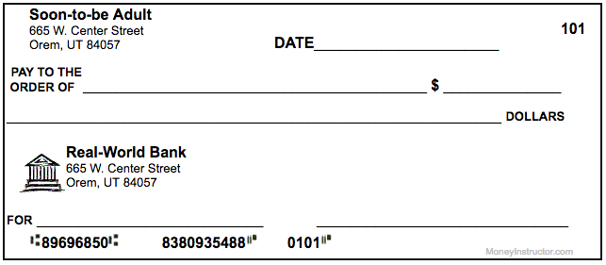
Cut the check
Write me a check for the entire amount of two year’s worth of expenses (taxes, insurance, and your phone bill) & put it in the basket

