Slide 2
Populism
Populism – A member of a political party claiming to represent the common people
Elites are mistreating the common people
If the common people cooperate, they can overthrow the elites

Slide 3
House of Representatives
435 seats
236 Republicans
191 Democrats
218 = majority
290 = supermajority

Slide 4
Senate
100 seats – 34 seats up for election
51 Republicans
47 Democrats
Majority = 51
Supermajority = 60

Slide 5
Supreme Court
Chief Justice John Roberts (conservative)
Clarence Thomas (conservative)
Samuel Alito (conservative)
Antonin Scalia (deceased — seat up for grabs)
Anthony Kennedy (swing)
Ruth Bader Ginsburg (liberal)
Sonia Sotomayor (liberal)
Elena Kagan (liberal)
Stephen Breyer (liberal)

Slide 6
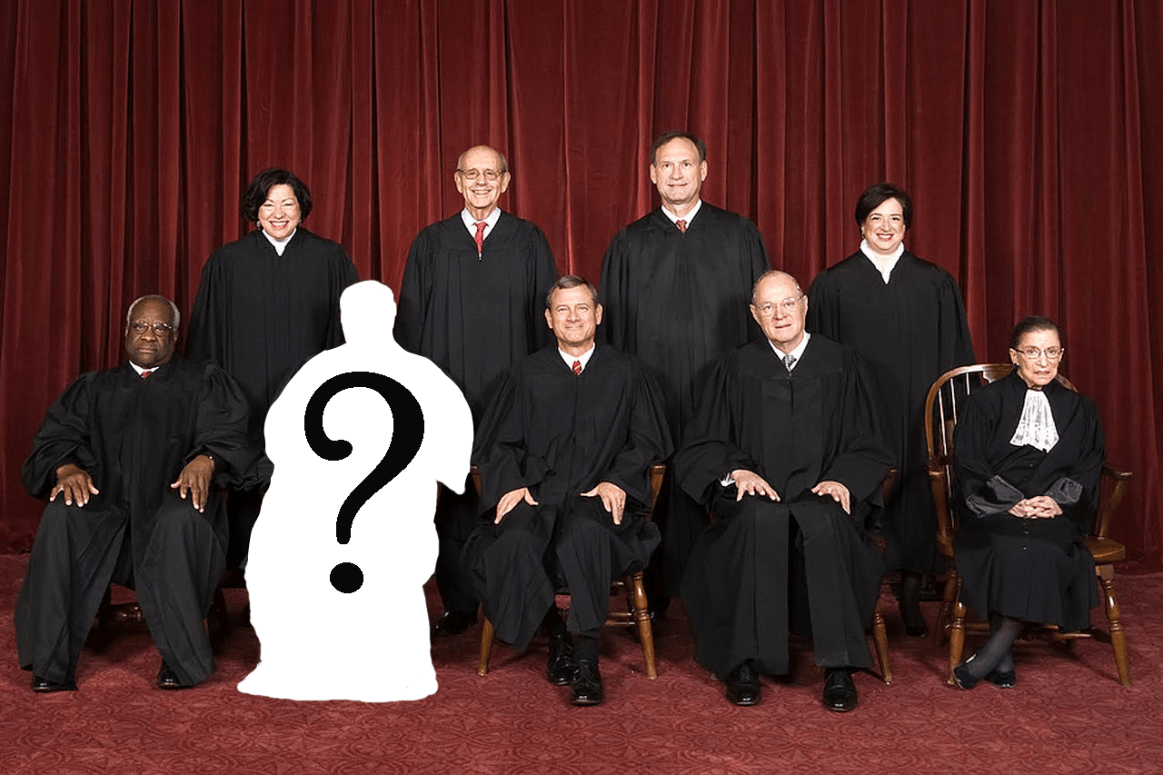

Slide 7
State-level power
Republicans fully control 30 state legislatures
Democrats fully control 11 state legislatures
Republicans fully control politics in 24 states (governor position AND state legislatures)
At least 64% of governors will be Republican
Since 2009, Democrats have lost 910 state legislature seats, 12 governors, 69 House seats, and 13 Senate seats

Slide 8
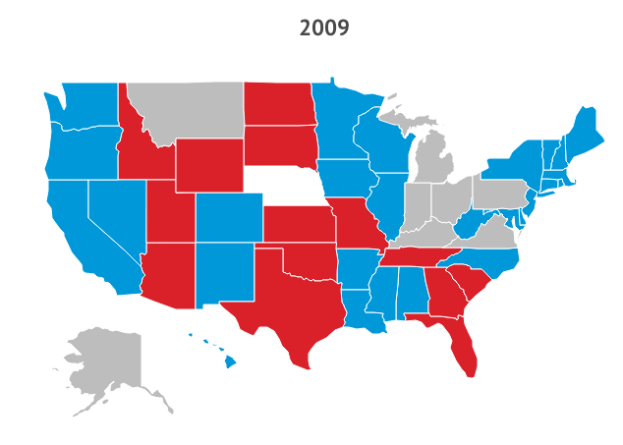

Slide 9
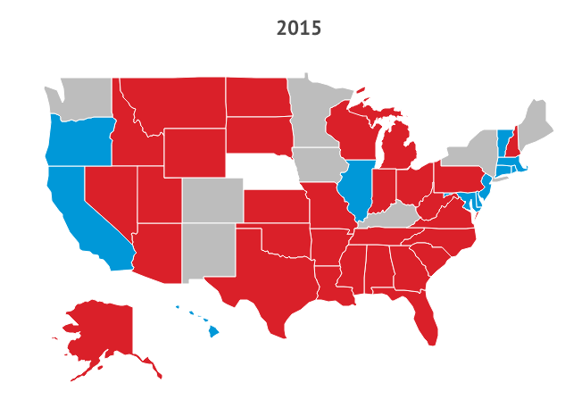

Slide 10
It’s a tie!
The House of Representatives chooses between the 2
Each state gets 1 vote
To win, a candidate needs more than half the states
If it’s still a tie, the House votes until it’s not
If no president is chosen by Jan. 20th, the VP takes power & the House keeps voting
If the VP race is tied too, the Speaker of the House takes power & the House keeps voting

Slide 11
The Election
The new President-elect is… Donald Trump
Utah’s governor is... Gary Herbert (no change)
Utah’s senators are... Mike Lee & Orrin Hatch (no change)
Utah’s representatives are... Mia Love, Jason Chaffetz, Rob Bishop, Chris Stewart (no change)
The Alpine bond... Passes
Amendment A... Passes
Amendment B... Passes
Amendment C... Fails

Slide 12
President-elect
The new president will take office on Jan. 20
Transition teams will begin working with the Obama White House to hand off power in a peaceful, orderly fashion
The White House Twitter, Instagram, Facebook, Tumblr, YouTube, Medium, etc., accounts will be preserved and then handed off to the 45th president

Slide 13
Presidential cabinet
Department of State
Department of the Treasury
Department of Defense
Department of Justice
Department of the Interior
Department of Agriculture
Department of Commerce
Department of Labor
Department of Health and Human Services
Department of Housing and Urban Development
Department of Transportation
Department of Energy
Department of Education
Department of Veterans Affairs
Department of Homeland Security

Slide 14
The first 100 days
Popularly considered to be the most important period of a new president’s time in office
Supposedly it’s when the president has the highest approval rating and can therefore get the most done

Slide 15
Trump’s 100 days
Announce plans to renegotiate or cancel NAFTA
Announce plans to withdraw from Trans-Pacific Partnership
Nominate a Supreme Court justice
Cancel funding to “sanctuary cities”
Remove illegal immigrants & cancel visas to countries that refuse to take them back (11.4M)

Slide 16
Trump’s 100 days
Suspend immigration from “terror prone” regions of the world
Propose a Constitutional Amendment to impose Congressional term limits
Propose a hiring freeze on all federal employees
Propose a new requirement that for every federal regulation imposed, 2 existing regulations will be eliminated

Slide 17
Trump’s 100 days
Propose a 5-year ban on White House and congressional officials becoming lobbyists
Propose a lifetime ban on White House officials lobbying foreign governments
Propose a ban on foreign lobbyists raising money in American elections

Slide 18
Let’s say…
Let’s say Trump gets bored and decides he doesn’t want to be president…
(or he gets convicted of something)
Mike Pence will become president
Pence will then get to appoint a new VP
Congress will have to OK his VP choice

Slide 19
Day 11: Happy 36th!
Congress & Presidents

Slide 20
Rolling for children
If you had a baby when you were 30 (Day 8), that child is now 6-8 years old → no daycare cost
If you had a baby when you were 32 (Day 9), that child is now 4-6 years old → no daycare cost
If you had a baby when you were 34 (last time), that child is now 2-4 years old → yes daycare
If you have a baby today, that child is 0-2 → yes daycare

Slide 21
Rolling for children
If this is your first baby:
Name it (must be OK’d by the government)
Hospital = $10,000 (you pay until you hit your deductible)
1st year of life cost = $13,000
Daycare cost = $10,000
$6,000 in tax breaks

Slide 22
Rolling for children
If this is your 2nd baby:
Name it (must be OK’d by the government)
Hospital cost = $10,000 (you pay until you hit your deductible, then insurance pays)
1st year of life cost for Child No. 2 = $10,000
Cost for child No. 1 = $13,000
Daycare cost = $20,000
$11,000 in tax breaks

Slide 23
Rolling for children
If this is your 3rd baby:
Name it (must be OK’d by the government)
Hospital cost = $10,000 (you pay until you hit your deductible, then insurance pays)
1st year of life cost for new baby = $8,000
Cost for other children = $26,000
Daycare = $10,000 for each child not in school
$16,000 in tax breaks

Slide 24
Rolling for children
If this is your 4th baby:
Name it (must be OK’d by the government)
Hospital cost = $10,000 (you pay until you hit your deductible, then insurance pays)
1st year of life cost for new baby = $6,000
Cost for other children = $34,000
Daycare = $10,000 for each child not in school
$21,000 in tax breaks

Slide 25
Calculate
Find your normal expenses for the day
Taxes
Housing
Food
Health insurance
Transportation
Pay off any new expenses you accrued today

Slide 26
Back to Congress!
Find your subcommittee

Slide 27
Legislative process
Subcommittee → Committee → Full House
A simple majority is needed to move a finished bill out of your subcommittee
Once in committee, compare bills and vote on one of them, or combine their best features into a new bill
A simple majority is needed to move the bill out of committee
Only 1 bill from each committee can move on

