Slide 1
Day 21: Happy 56th!
Something new

Slide 2
Rulemaking
Government agencies have the right to create their own rules, if the law says so
Regulation/rule: An order having the force of law, prescribed by a superior or competent authority
Congress will sometimes pass vague legislation & let agencies fill in the blanks

Slide 3
Rulemaking (regulations)
The process:
Congress passes a law, leaving blanks to be filled by agencies
Agencies publish a proposed regulation
The public comments on the proposal
(or not)
The proposal becomes law

Slide 4
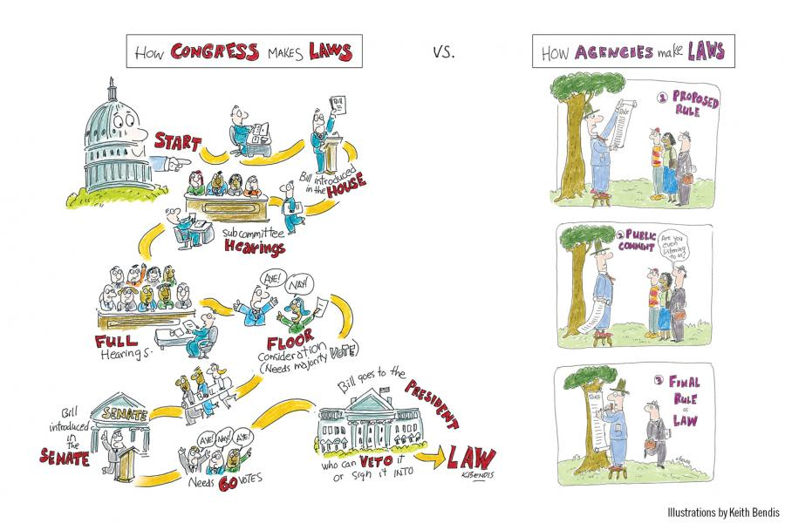

Slide 5
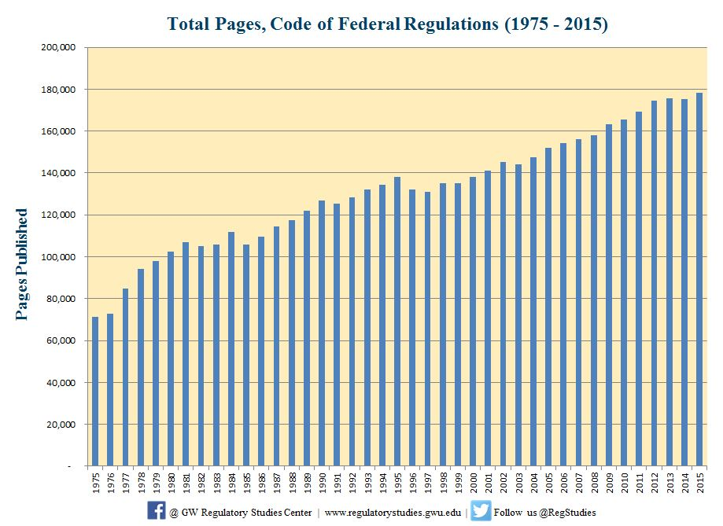

Slide 6
Regulations: Yes or No?
Should a restaurant have a business license in order to operate?
Should food items be required to carry nutrition labeling?
Should restaurants have to put the calorie count of each item next to the item on their menu?
Should the government penalize people who mislabel food items?
Should putting poison in food be against the law?

Slide 7
Regulations: Yes or No?
Should filthy, putrid, or decomposed things be kept out of food sold in stores?
Should people be able to sell meat taken from a diseased animal?
What about road kill?
Should a minimum wage exist? What should it be?
Should businesses give employees a $15 an hour wage?
Should workers be limited to 40 hours a week?

Slide 8
Regulations: Yes or No?
Should food exposed to radiation be allowed?
Should it be OK to add food coloring to food items to make the items look better?
Should imitation items (imitation cheese, vanilla, etc.) have to say the word “imitation” on their packages?
Should accurate weights be printed on food items?
Should accurate ingredients be printed on items?
Should the government be able to shut down dirty or unsanitary food establishments?

Slide 9
Regulations: Yes or No?
Should the government be able to regulate what the outside of your business’s building looks like?
Should the government be able to issue recall notices on items that are deemed unsafe?
Should you need a food handler’s permit in order to cook food that will be sold to customers?
Should the government be able to require private companies to give up/destroy some products in order to keep that particular industry stable?

Slide 10
Occupational licenses:
Should you need a license in order to:
Tell fortunes (Md.)
Shampoo someone’s hair (Ala., La., N.H., Tenn.)
Arrange flowers (La.)
Braid hair (24 states)
Be an interior designer (Fla., La., Nev., D.C.)
Be a makeup artist (36 states)
Be a tour guide (D.C., La.)
Interpret for the deaf (Ill., Texas)
Upholster furniture (Utah)
Notes:
84 categories in Utah

Slide 11
Pay day!
If you have a master’s degree: $60,000
Make sure you’ve paid your $20,000 in tuition
If you have a bachelor’s degree: $50,000
Make sure you’ve paid your $40,000 in tuition
If you only turned in a resume: $20,800
If you’re still @ minimum wage: $15,080

Slide 12
First: Federal taxes
Single-person tax brackets:
$15,080 = 17.65% of your paycheck
$20,800 = 22.65% of your paycheck
$49,920-$50,000 = 32.65% of your paycheck
WAIT! Subtract $4000 from your taxes
Married tax brackets:
<$18,550 combined = 17.65% of your paycheck
$18,550-$75,000 = 22.65% of your paycheck
$75,000-$151,000 = 32.65% of your paycheck
WAIT! Subtract $8,000 from your taxes

Slide 13
Second: State taxes
State income tax:
Find 5% of today’s paycheck and include it in what must be paid to the IRS

Slide 14
Other yearly expenses
Total your normal costs for:
Car insurance
House payments OR rent
Food

Slide 15
Children
To keep any $5,000 tax breaks, you can keep claiming the kids as your “dependents” even after they turn 18
BUT you must also pay life costs
IF you kick the child out of the house when he/she turns 18, you lose your $5,000 tax credit
BUT you don’t have to life costs

Slide 16
COL: Utilities
* W/roommates, pay $200/# of roommates
* If you live alone, pay $200
*If you own a home, pay:
Water bill: $100 per month
Garbage/sewer: $15 per month
Gas bill: $150 per month
Electric bill: $75 per month

Slide 17
COL: City fees
County general funds: $300
School levy (tax): $800
State basic school levy (tax): $200
Library tax: $30
City tax: $400
Mosquito abatement: $15
County water: $30
Central Utah water cost: $50
Multi-county assessing and collecting: $1
County assessing and collecting: $50

Slide 18
COL: Must/can
MUST pay:
Gas/car upkeep: $10,000 per year
Clothing: $2,000 per year
CAN pay:
Phone bills: $360 per year
Internet: $840 per year
Entertainment: $2,000 per year

Slide 19
Mayhem!
But good stuff, for a change

Slide 20
Mayhem!
Yellow: Christmas bonus! $300
Red: You found $500 on the street & it remained unclaimed for 90 days. Enjoy!
Green: A better Christmas bonus — $1,000
Purple: You found $3,000 in an antique you bought
Brown: You rented out your house for filming. $7,000
Orange: You won a gold medal! $25,564
Light blue: You inherited $50,000!

Slide 21
Orange
Orange: You won a gold medal! $25,564
U.S. Olympians must pay taxes on their medals:
$25,000 prize for the gold medal
$564 for the cost of the gold
Total the taxes you owe with $25,564 added to your income and be prepared to pay the new total to the IRS

Slide 22
Light blue
Light blue: You inherited $50,000!
Add $50,000 to your income — if your income totals more than $151,000, you move up a tax bracket for this year
35.65% (federal) and 5% (state)
Subtract $10,000 from that $50,000 to pay for the funeral
Enjoy your leftover money

Slide 23
Starting a business
Decision time!

Slide 24
Types of businesses
Sole proprietorship: 1 person is 100% responsible for all of the control, liabilities and management
Partnerships: 2 people agree to share a business and each have unlimited liability for the business
Limited partnership: Limited partners contribute money toward a business, but rarely anything else
Corporations: Approved by state, incorporators choose a board of directors and the board hires managers, shareholders are owners (limited liability)
Limited Liability Corp: Like a partnership w/less liability

Slide 25
Choose your business!
Cinnabon
Krispy Kreme
KFC
Zaxby’s
Dunkin’ Donuts
Cold Stone Creamery
Menchie’s
McDonald’s
Sonic
Carl’s Jr.
Taco Bell
Del Taco
Pizza Hut
Subway
Jimmy John’s
Corner Bakery Cafe

Slide 26
Business startup costs
Cinnabon ($180.1K-$385.5K)
Krispy Kreme ($275K-$1.9M)
KFC ($1.3M-$2.5M)
Zaxby’s ($215.1K-$655.1K)
Dunkin’ Donuts ($216.1K-$1.5M)
Cold Stone Creamery ($2677.4K-$464.3K)
Menchie’s ($218.3K-$385.2K)
McDonald’s ($1M-$2.3M)
Sonic ($1M-$1.6M)
Carl’s Jr. ($1.3M-$1.9M)
Taco Bell ($1.2M-$2.6M)
Del Taco ($767.7K-$1.6M)
Pizza Hut ($297K-$2.1M)
Subway ($116.6K-$263.2K)
Jimmy John’s ($330.5K-$519.5K)
Corner Bakery Café ($843K-$2.4M)

