Slide 1
Day 6: Happy 26th
Something’s happening…

Slide 2
Calculate your expenses…
Your numbers WON’T change from last time unless you got married
IF you got married, DON’T:
Subtract the $15,000 wedding again
Subtract the $40 marriage license

Slide 3
Yearly expenses
Deposit your pay for the year
Calculate your taxes from that paycheck and subtract the amount from your $$$
Add the leftover money to last time’s total
Subtract other expenses:
Housing
Car insurance
Food
Write your check for what you owe

Slide 4
Tax brackets
Single-person tax brackets:
$15,080 = 17.65% of your paycheck
$20,800 = 22.65% of your paycheck
$49,920-$50,000 = 32.65% of your paycheck
WAIT! Subtract $4000 from your tax before paying
Married tax brackets:
<$18,550 combined = 17.65% of your paycheck
$18,550-$75,000 = 22.65% of your paycheck
$75,000-$151,000 = 32.65% of your paycheck
WAIT! Subtract $8,000 from your tax before paying

Slide 6
The U.S. military
The U.S. military is a volunteer force and has been since 1973
Prior to that, all American males ages 18-26 were eligible to be drafted, even in times of peace
The draft was ended by President Richard Nixon

Slide 7
The U.S. draft
Benefits of having an all-volunteer military?
M
K
K
K
Negatives of having an all-volunteer military”
D
D
D
d

Slide 8
The U.S. draft
The last military draft was held during the Vietnam War
(Unofficial) wars fought since then:
Deseret Storm
War in Afghanistan (War on Terror)
War in Iraq

Slide 9
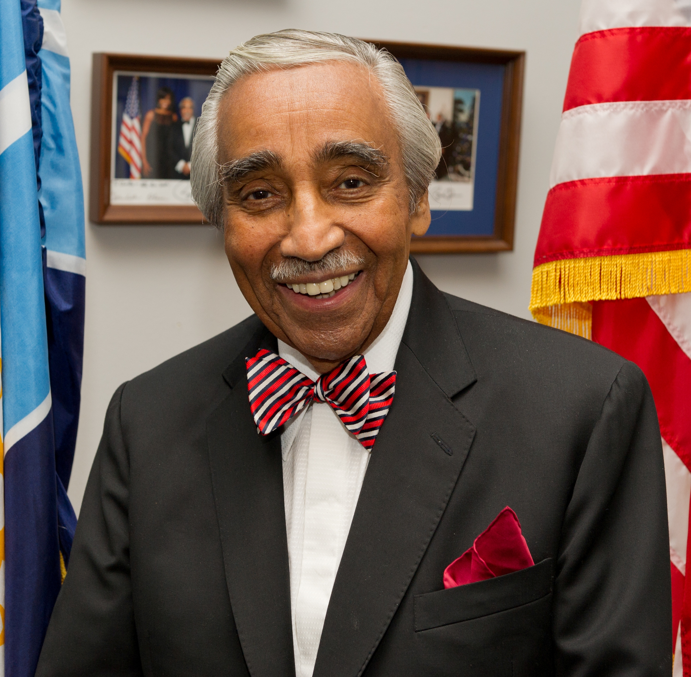
Reinstating the draft
Rep. Charles Rangel (D-N.Y.) re-introduces draft legislation every year
He’s a veteran of the Korean War
Why would he support a draft?

Slide 10
The draft today
Selective Service: All men 18-26 must register
Non-citizens must register unless they are on a student or visitor visa OR they are part of diplomatic or trade missions
Dual nationals MUST register regardless of location
Residents of Puerto Rico, Guam, Virgin Island, and Northern Mariana islands must register; citizens of American Samoa must be habitual residents to register

Slide 11
The draft today
Young men in hospitals, mental institutions, or prisons do not have to register while committed, but must register within 30 days of being released
Disabled men must register if they can reasonably leave their homes and move about independently
Men who joined the military before age 18 don’t have to register, but they DO have to register if they leave before turning 26
Transgender people do not have to register

Slide 12
Women vs. the draft
In December 2015, the Defense Secretary opened ALL combat roles to women
The Marine Corps asked for a partial exception in some areas, but it was denied
A Marine Corps-sponsored study found:
Male-only infantry units shot more accurately
Male-only units could carry more weight
Male-only units could move more quickly through some tactical maneuvers
Women had higher injury rates than men

Slide 13
Women in the draft: Debate
Hillary Clinton supports having women register for the draft, but also keeping the volunteer military
Sen. Claire McCaskill (D-Mo.): “It’s just a matter of time” until women are treated equally
Republican-controlled Senate voted 85-13 on an bill that would require women to register
(Vetoed by Obama on Oct. 22nd)
Conservative politicians tend to oppose having women register for the draft

Slide 14
WAR
DRAFT DAY

Slide 15
To have a draft
The House AND Senate must pass legislation authorizing a draft
The president must sign the legislation
20-year-olds will be drafted first, then 21, 22, 23, 24, 25, 26

Slide 16
How it works
366 capsules containing calendar dates are dumped into a hopper
366 capsules with numbers 001-366 are dumped into a separate hopper
A date is drawn, then the number
Those with the lowest numbers would be drafted first

Slide 17
Your options
Report to bootcamp & serve
Volunteer for service w/o being drafted
Deferments or exemptions
Conscientious objection
Refuse to report/Go to jail
Flee the country

Slide 18
Report to bootcamp & serve
Getting drafted is the first step — you still have to pass the physical and be OK’d for service
Order to Report for Physical Examination
Fit to serve = 1-A classification
You had 10 days to file for an exemption, postponement, or deferment
Most draftees go to the Army or the Marine Corps

Slide 19
Volunteer w/o being drafted
Why?
You choose your own branch of service
You would serve with other volunteers
Enlistment bonuses
You can volunteer for a draft — in return you get a shorter term of active duty

Slide 20
Deferments or exemptions
Hardship or dependency
Medical (physical or psychological) disability
Surviving son or daughter
Parenthood
Ministerial student
College student (sort of)

Slide 21
Conscientious objection
You MUST appear before your local draft board
You MUST present written documentation or witnesses to support your claimed beliefs
How you arrived at your beliefs
The influence your beliefs have on how you live
Beliefs MUST be moral or ethical; they CANNOT be based on politics, expediency, or self-interest
Alternate service options: Non-combatant role or government-approved employment

Slide 22
Refuse to report/jail
Failure to register or comply with the Selective Service Act is a FELONY
May face a fine of up to $250,000
May face a prison term of up to 5 years
Anyone helping a person dodge the draft is subject to the same penalties
Gov’t penalties: Financial aid, licenses

Slide 23
Flee the country
It is illegal to leave the country in order to evade the draft
Another country must accept you as an ex-pat
It is a FELONY to return to the U.S.
You may never see your family or friends in the U.S. again

Slide 24
Enlistment bonus
A $15,000 bonus is available…

Slide 25
Exit ticket
What do you think about the draft as a whole? What do you think about ALL roles in the U.S. military being opened to women? What do you think about women having to register for the draft? Why? If we had a draft tomorrow, what would you do? Pick from the 6 categories and explain why that would be your choice. What factors might affect your decision?

