Slide 1
Zoning
All U.S. cities are divided up into zones where only certain types of buildings are allowed
Residential Zoning
Commercial Zoning
Industrial Zoning
Agricultural Zoning
Rural Zoning
Combination Zoning
Historic Zoning
Aesthetic Zoning
Permitted and Accessory Uses

Slide 2
Zoning
Take your best guess how Orem City is zoned, using the map on the next page
Residential zoning
Industrial/manufacturing zoning
Commercial zoning

Slide 3
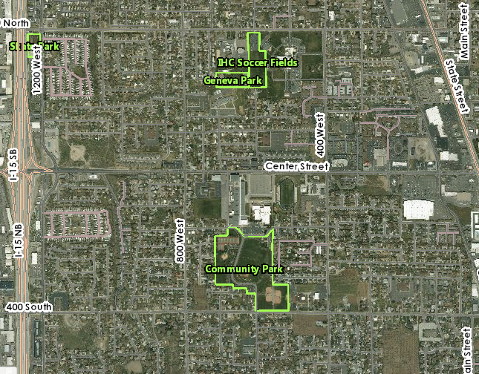

Slide 4
Are you ready to see how you did?
The next slide will show you the answers…

Slide 5
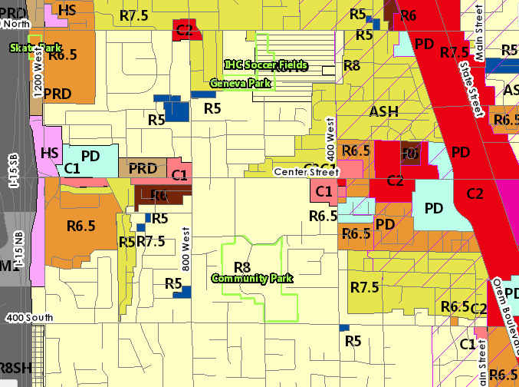

Slide 6
Notes:
http://www.orem.org/commercial-professional-office-zone-regulations/
http://www.orem.org/setbacks/
http://www.orem.org/landscaping/
http://www.orem.org/pdf/ds/3291.pdf
http://exe.orem.org/citycode/Appendix_K.pdf
http://www.orem.org/residential-setbacks/

